Slide 1
Appendix
ENHANCING YOUR DOCUMENTS WITH GRAPHICS
Notes:
Appendix, p. 203

Slide 2
Visuals for Presentations
Use visuals in presentations to help keep your audience attentive, and facilitate understanding.
  Handouts
  Portable flip pads
  Posters
  Overhead projectors
  Slide projectors
  Computer projection programs
Notes:
Appendix, p. 210

Slide 3
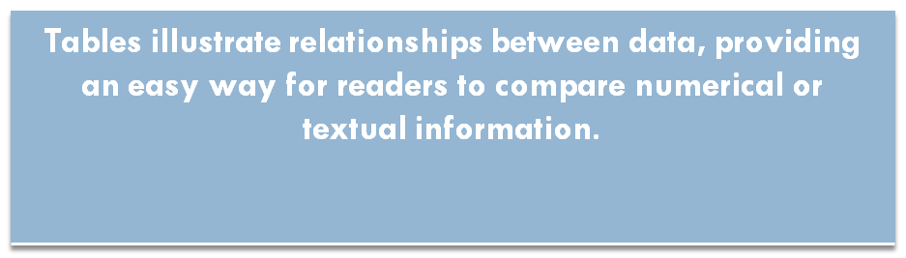
Tables
Tables help the reader interpret data.
 | Data 1 | Data 2 | Data 3 | Data 4
Category 1
Category 2
Category 3
Category 4
Notes:
Appendix, p. 203

Slide 4
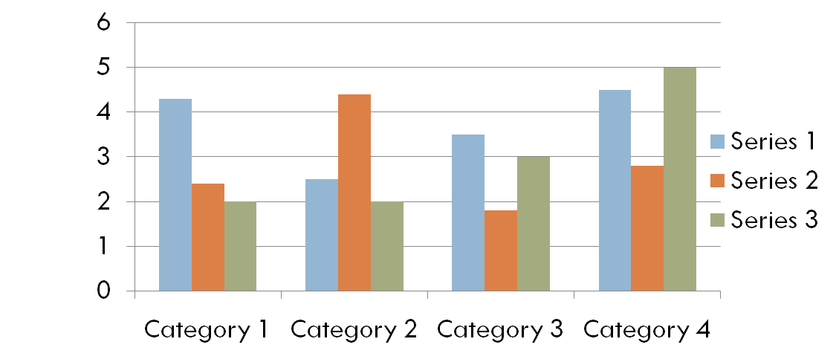
Graphs
Graphs normally illustrate two or more variables interacting, such as stock prices over a period of time.
Notes:
Appendix, p. 203

Slide 5
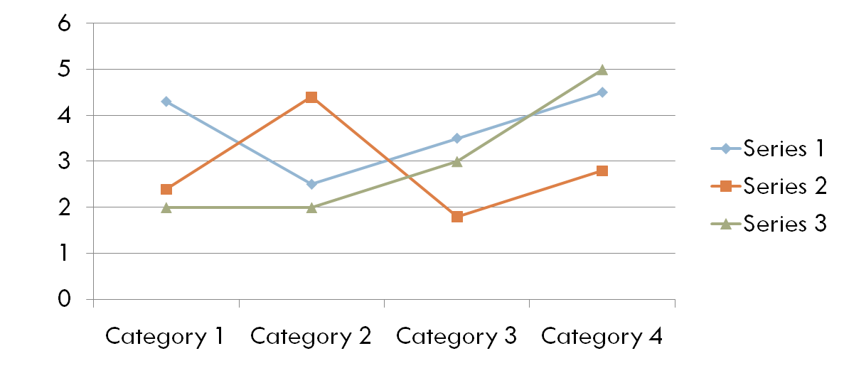
Graphs
Line graphs may be used to plot a continuous change of something over time.
Notes:
Appendix, p. 206

Slide 6
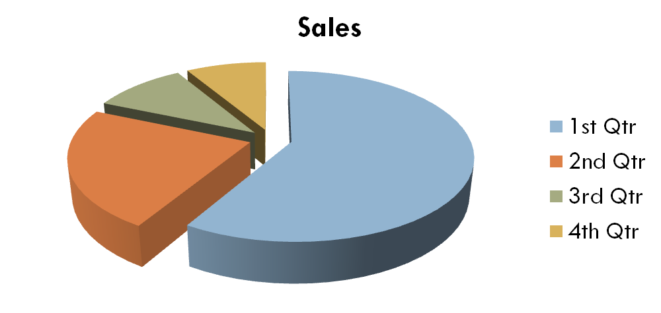
Graphs
Pie graphs, or pie charts, work well when differences need to be emphasized.
Notes:
Appendix, p. 209

